Slide 1




PF PROJECT
CLIMATE
IMPACT CALCULATOR
  Wasif Ali (245187)
  Jawad Mustafa (245195)
  Mubashir Ali (245185)
  Anisa Khan (245215)
  Faiqa Umer (245161)

Slide 2
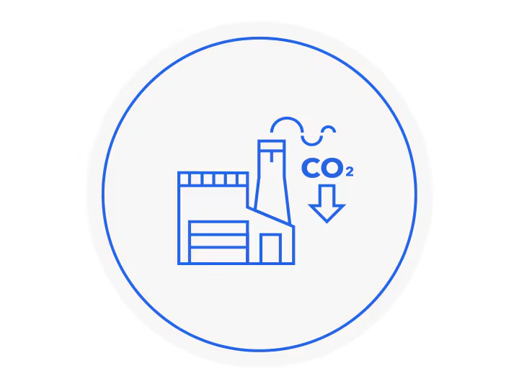
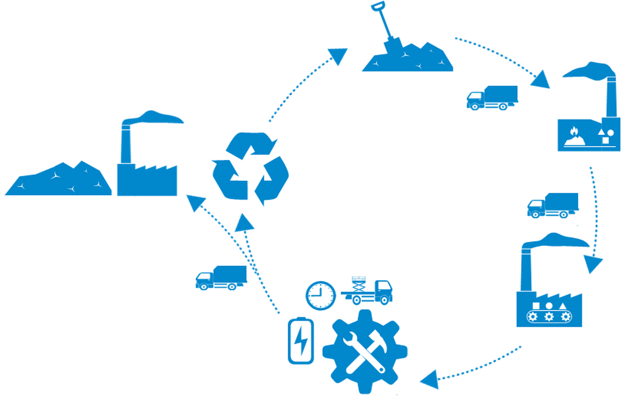
OBJECTIVES
Main Objective:
Develop a tool that calculates carbon emissions and provides actionable insights to mitigate climate change impact.
Specific Goals:
  Accurately estimate carbon emissions from daily activities.
  Calculate the Air Quality Index (AQI).
  Suggest carbon offset methods (e.g., trees, solar panels).
  Compare transportation modes for emissions.
  Predict future emissions based on current data.
  Save reports for future reference.

Slide 3


PROBLEM STATEMENT
  Develop a program to assess human activities' impact on climate change.
  Measure carbon emissions from daily actions.
  Provide insights on activities contributing to environmental harm.
  Offer data-driven suggestions for reducing carbon footprints.
human activities' impact on climate change.

Slide 4


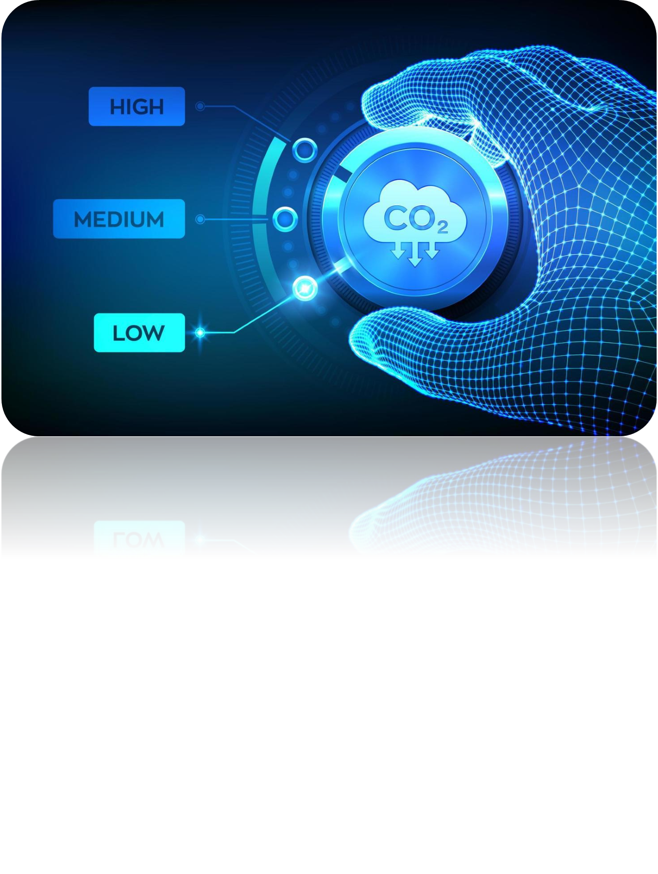
INTRODUCTION
Climate Challenge:
  Carbon emissions significantly contribute to environmental degradation and climate change.
  Need for accessible tools to quantify individual contributions to global emissions.
Solution:
  A user-friendly program to calculate and analyze carbon footprints and provide actionable insights.

Slide 5
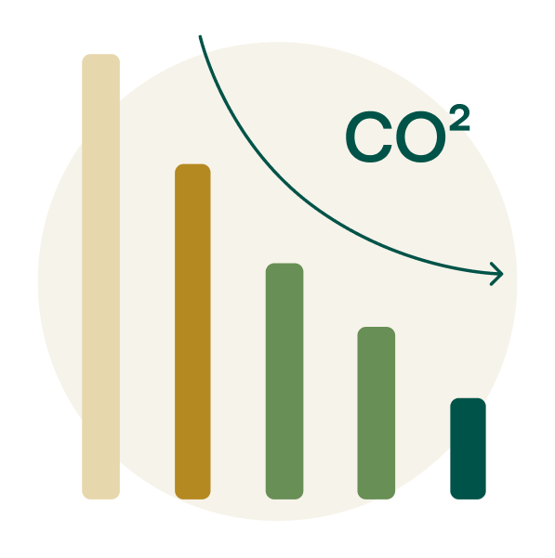
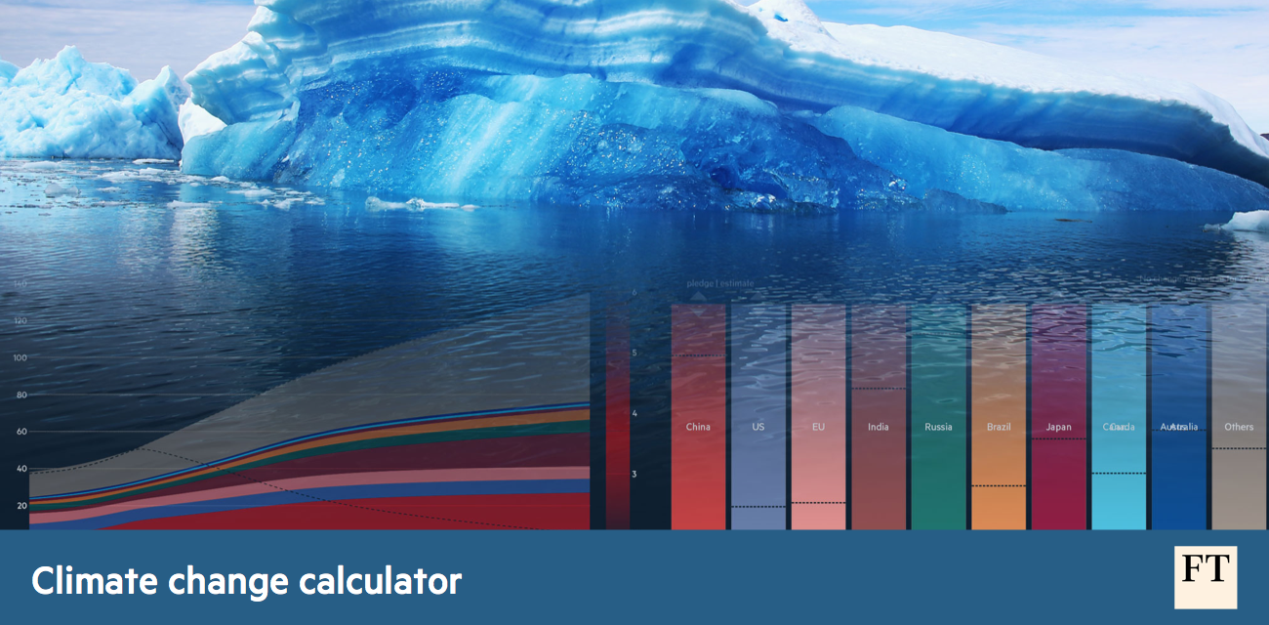
FEATURES AND FUNCTIONALITIES
Key Features:
  Activity-wise carbon emission calculations.
  Air Quality Index (AQI) determination.
  Carbon offset recommendations (trees, solar panels).
  Transportation mode comparison (car vs. bus).
  Future emissions prediction.
  Bar chart visualization of emissions.
  File-saving for reports and results.

Slide 6
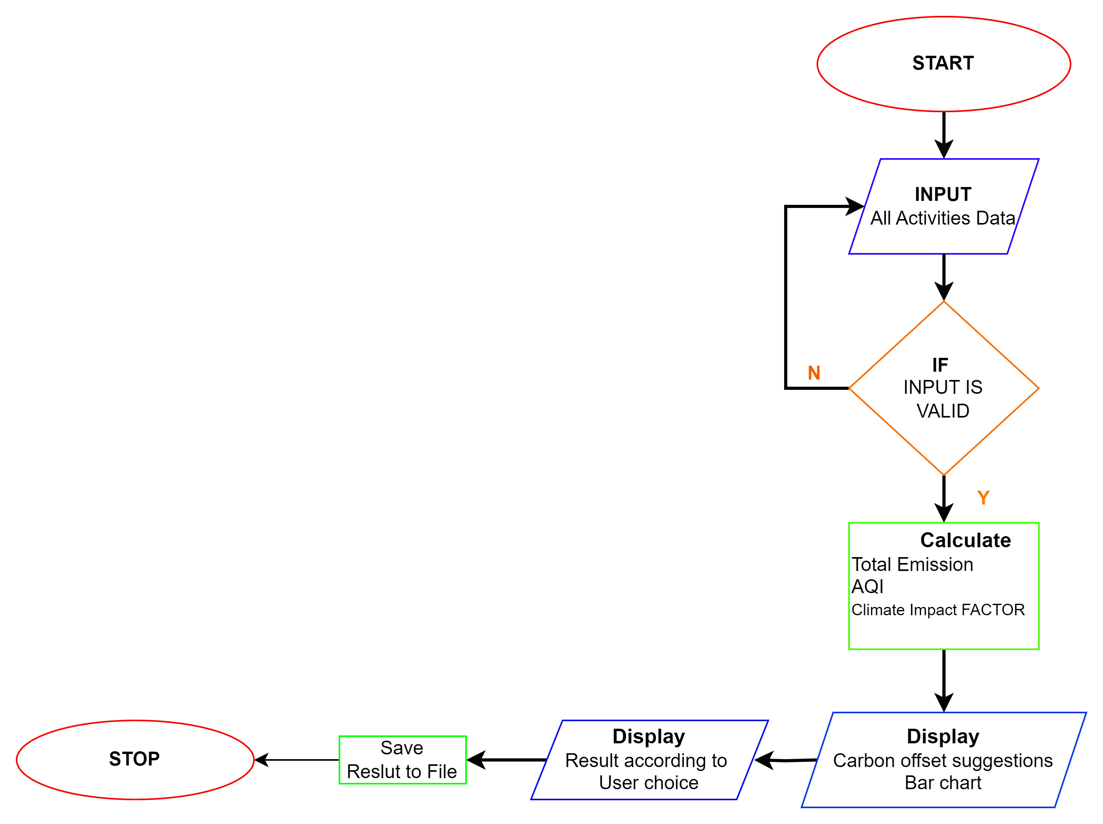

ALGORITHM AND FLOWCHART
Algorithm Overview:
Take user inputs for various activities (e.g., car travel, electricity usage).
Validate inputs (handle invalid or negative values).
Calculate emissions and AQI.
Provide carbon offset suggestions.
Visualize results through bar charts.
Save results to a file.
Allow additional menu-based interactions.
SIMPLIFIED FLOWCHAT

Slide 7


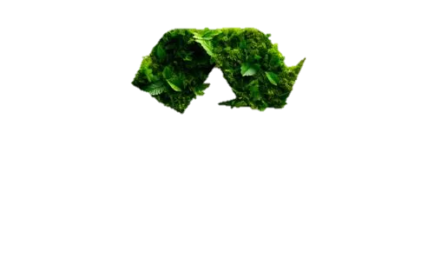
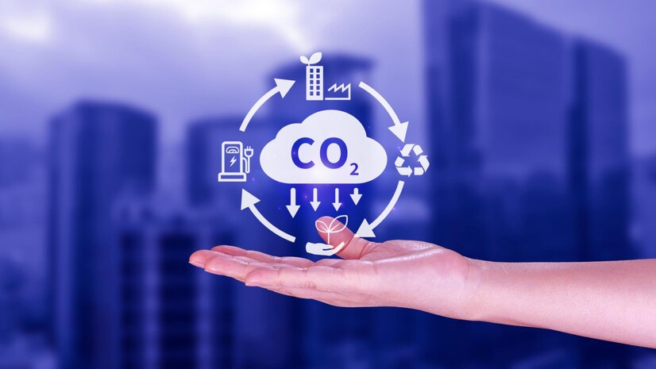

CODE DESIGN
Modularity:
  Input Module: Collects user data and validates it.
  Processing Module: Calculates emissions, AQI, and offsets.
  Visualization Module: Creates bar charts for emissions.
  File Management Module: Saves results to a text file.
Header Files:
  <thread> and <chrono> for progress bars and delays.
  <iostream> and <fstream> for input/output and file handling.

Slide 8

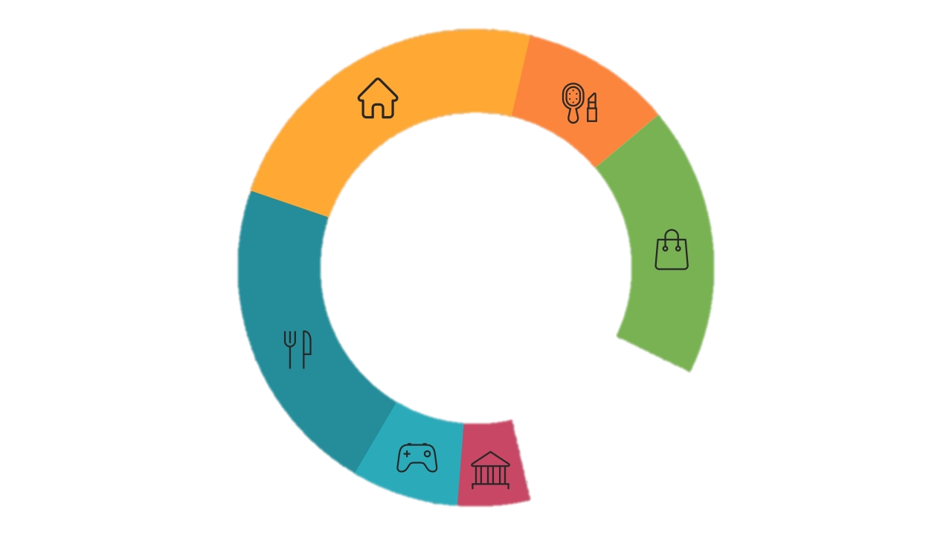


IMPLEMENTATION HIGHLIGHTS
Data Collection
Mathematical Calculations
Interactive Features
File Handling
Visual Enhancements
Comparative Insights
2,400
kg CO2
Estimated

Slide 9
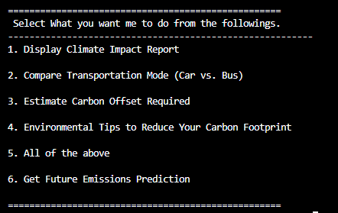
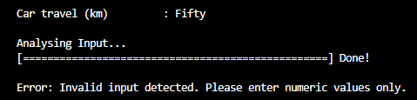
USER INTERACTION
Interactive Features:
  Menu-driven interface for selecting program options.
  Progress bars simulate real-time processing.
  Error messages ensure valid user input.

Slide 10



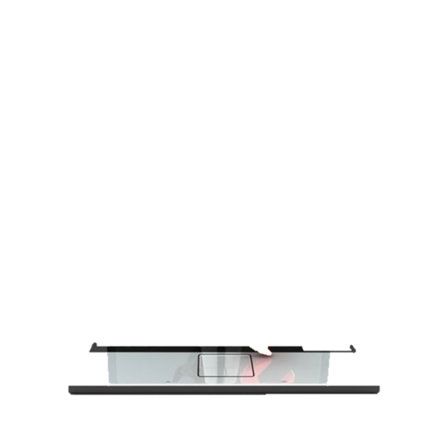
TESTING
Testing Objectives:
  Validate correct calculations for emissions and AQI.
  Test robustness with invalid and edge-case inputs.
Example Test Cases:
TEST CASE | INPUT | EXPECTED OUTPUT | RESULT
Valid Input | Car: 100 km | Correct emissions | Passed
Invalid Input | Car: "abc" | Error message shown | Passed
Zero Input | All: 0 | Total emissions = 0 | Passed
Large Emissions | Car: 10,000 km | AQI = 500 (max) | Passed
Results:
  All test cases passed successfully.

Slide 11


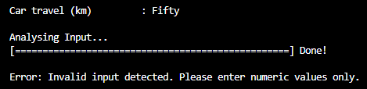
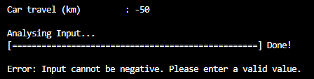
ERROR HANDLING
Importance of Error Handling
  Ensures robust program functionality by preventing crashes or incorrect calculations.
  Improves user experience by guiding users with clear feedback.
Key Error Handling Features
  Invalid Input Detection:
      Uses cin.fail() to check for non-numeric input.
      Provides an error message: "Invalid input detected. Please enter numeric values only.“
  Negative Input Handling: Ensures users cannot input negative values.
  Displays a warning: "Input cannot be negative. Please enter a valid value.“
  Real-Time Feedback: Progress bar simulates input analysis while handling errors.

Slide 12
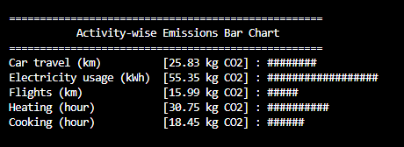
VISUALIZATION
Purpose of Visualization
  Helps users identify which activities contribute the most to their carbon footprint.
  Makes complex data (emissions) easy to understand and analyze through visuals.
Bar Chart Feature:
  Displays activity-specific emissions as proportional bars. Helps users identify high-emission activities.

Slide 13



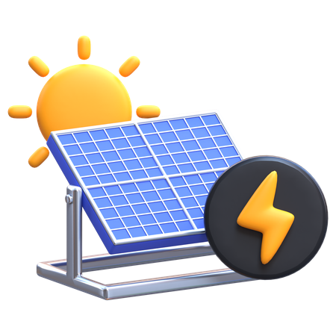
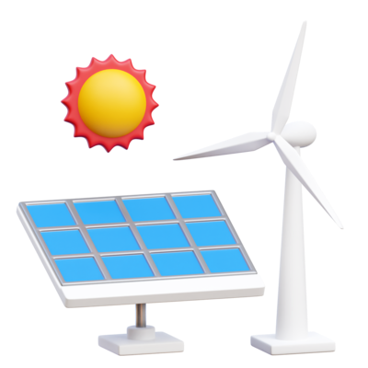
CARBON DEGRADATION SUGGESTIONS
Purpose
Provide actionable steps to offset or degrade carbon emissions, encouraging users to adopt sustainable practices.
Key Suggestions from the Program:
  Tree Planting
    Recommends the number of trees required to offset total emissions (e.g., 21 kg CO2 per tree annually).
    Example: "Plant approximately X trees to offset your emissions."
  Solar Panel Installation
    Calculates the number of solar panels needed to offset emissions (e.g., 500 kg CO2 per solar panel annually).
    Example: "Install approximately Y solar panels to achieve carbon neutrality."
  Switch to Renewable Energy
    Suggests investing in renewable energy projects.
  Lifestyle Changes
    Tips like reducing car travel, using energy-efficient appliances, and adopting a plant-based diet.

Slide 14
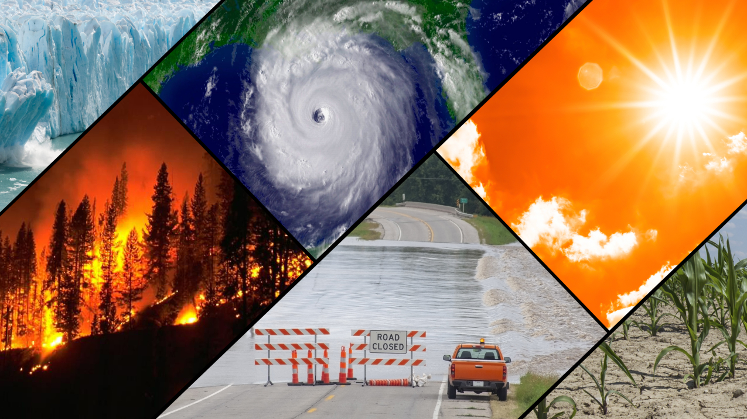
CHALLENGES AND LIMITATIONS
Challenges:
  Handling invalid and negative inputs.
  Ensuring realistic AQI scaling.
  Visualizing emissions proportionally in bar charts.
Limitations:
  Fixed emission factors may not cover all scenarios.
  No real-time data integration (e.g., sensors).
  Dependency on accurate user input.

Slide 15
















CONCLUSION
Developed a user-friendly tool for calculating and analyzing carbon emissions.
Provides actionable insights and encourages sustainable practices.
Successfully tested with all core functionalities working as expected.
The Climate Change Impact Calculator provides a comprehensive and interactive tool for assessing individual carbon footprints.
It combines accurate calculations, user-friendly visualizations, and actionable insights to promote environmental awareness.

Slide 16
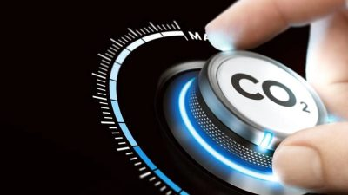

FUTURE WORK
Proposed Improvements
  Integrate real-time data from IoT sensors.
  Add advanced analytics like lifecycle emissions analysis.
  Develop web and mobile versions for wider accessibility.
  Allow customizable emission factors for greater accuracy.

Slide 17


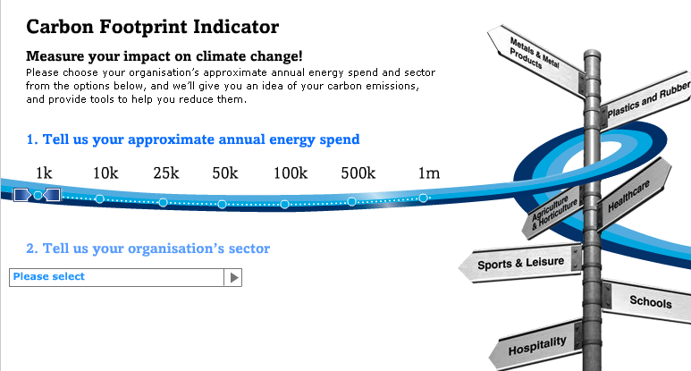
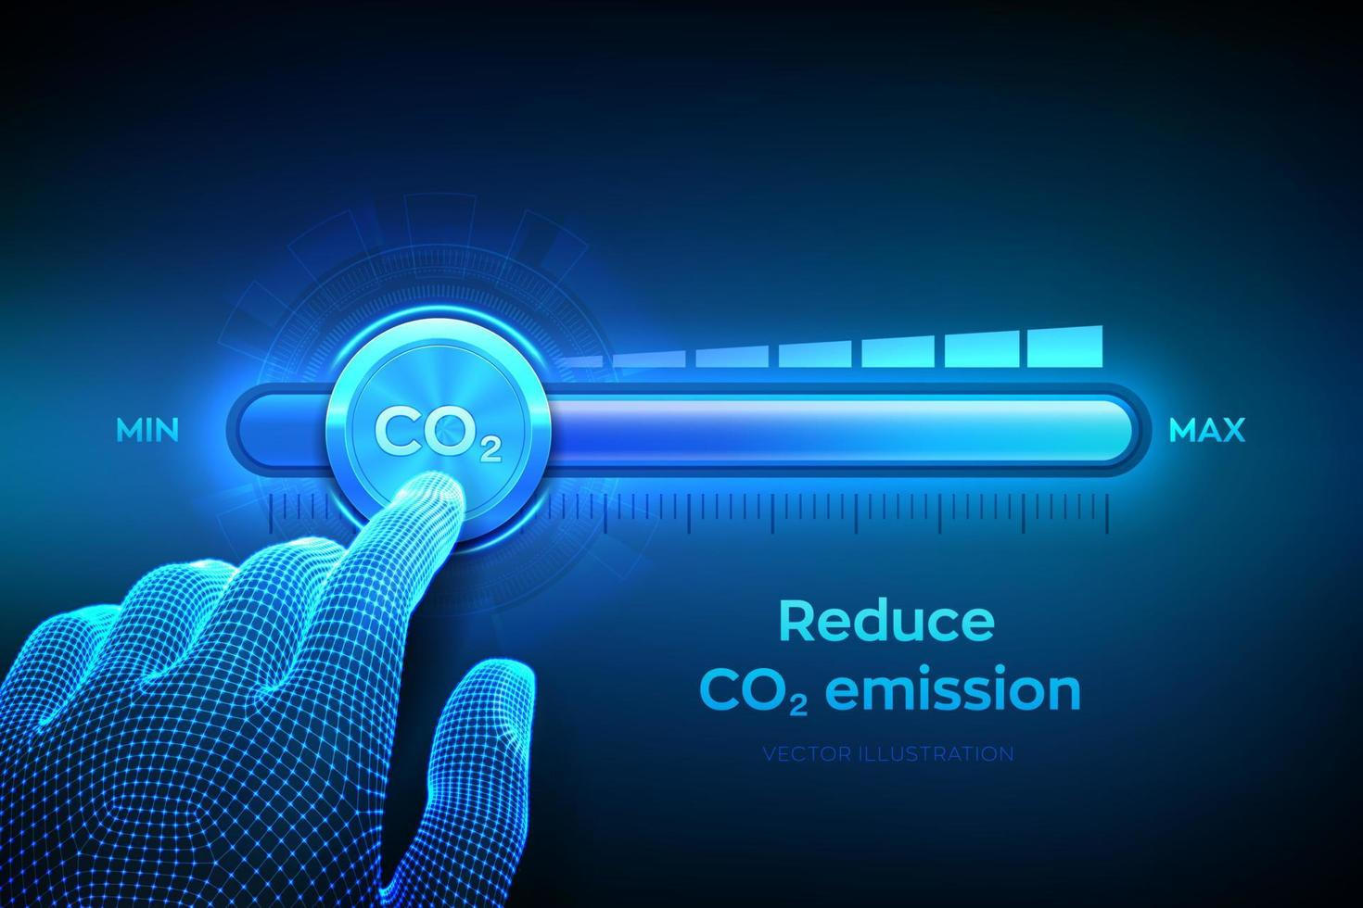
THANK YOU

